Slide 1
Deep Learning Approach for 2D MRI Brain
Tumor Segmentation
By:
Preethi reddy Kommidi
700745249
Video Link : https://drive.google.com/file/d/1fssU8MY7xwD6pEf9yh9zGIoWulMN0hdv/view?usp=sharing

Slide 2
Motivation
Brain tumour detection and segmentation using MR images are difficult but important tasks in the medical industry. Early detection and localization of brain tumours can prevent death and provide doctors the opportunity to choose effective treatment options.

Slide 3
Problem Statement
This research proposes a novel framework for deep neural networks (DNN)-based data augmentation techniques for segmenting 2D brain tumours in MR images. The proposed method (Znet) propagates the intrinsic affinities of a relatively small number of expertly delineated tumours, such as hundreds of patients with low-grade glioma (LGG), to many thousands of synthetic cases by utilising the concepts of skip-connection, encoder-decoder architectures, and data amplification.

Slide 4
Objectives
The ZNet model's capacity to identify and automatically segment brain tumours in MR images is demonstrated by the findings and visualisation of the DNN-derived tumour masks in the testing dataset. This strategy can also be applied to 3D brain volumes, other diseases, and a variety of picture modalities.

Slide 5
Contributions
A publicly available benchmark dataset based on The Cancer Genome Atlas Low-Grade Glioma (TCGA - LGG) was used in this investigation [31, 32]. Building cancer pictures for research and examining the relationship between phenotype and genotype in the study of cancer and medical images are the goals of the TCGA-LGG compilation.

Slide 6
Results:
The validation dice for detecting and segmenting the brain tumour on MR images was 0.96 after 200 iterations of training on the TCGA - LGG dataset. Each period is necessary.The data is typically split into two groups in data science applications: the training set and the testing set. the education set is additionally divided into the model training set and
set for model validation, the reason for segmenting the training set into two halves in order to prevent overtraining to ensure that model evaluation (during training) is a process is carried out using undiscovered data.

Slide 7
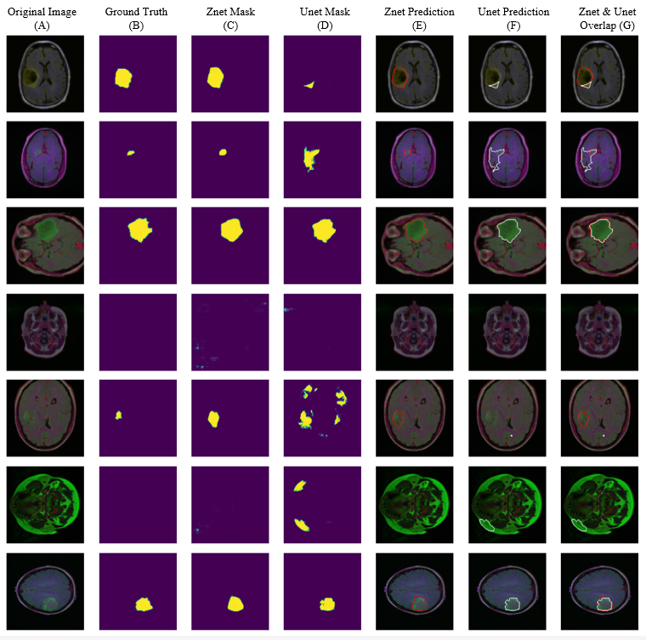
Visual results and comparison of MR images tumor segmentation using the proposed model(Znet) and the benchmark model Unet.

Slide 8
Conclusion:
Convolutional networks, a deep learning concept, and data augmentation, a new method for segmenting MR images has been developed. This method makes use of the available labelled pictures. The architecture relies on auto encoder-decoder, the idea of skip-connections, and residual neural networks, which necessitates merging the output of the previous layer with the next layer. To map the dimensions between each layer's input and output, features maps are also necessary. The advantage of skip-connections is that they can be used to uncover additional and alternative learning and gradient pathways, increasing the likelihood that the model would converge and avoiding the paradox of vanishing gradients [40].
Using a server with two NVidia Titan 12GB GPUs, the model was trained for 200 epochs, and the results revealed that it was accurate in predicting dice outcomes.

Slide 9
References
MOHAMMADASHRAFOTTOM and 1,2 ,HANIFABDULRAHMAN “Znet:DeepLearning Approach for 2D MRI Brain TumorSegmentation” 2022

